Slide 1

Power BI Introduction
Power BI is a business intelligence and data visualization tool by Microsoft.
It is used to analyze raw data and convert it into interactive dashboards and reports for better decision-making.
In Power BI, we mainly work with:
Power BI Desktop – for data modeling, DAX, and report creation
Power Query – for data cleaning and transformation (ETL)
DAX (Data Analysis Expressions) – for calculations, measures, KPIs
Visuals & Dashboards – charts, tables, slicers, and filters
Power BI supports multiple data sources like Excel, SQL Server, CSV, and databases.
It helps businesses track performance, identify trends, and make data-driven decisions.

Slide 2
📊 Product Sales Analysis Dashboard (Power BI)
Work Done in This Power BI Dashboard
Designed a clean and interactive Power BI sales dashboard to analyze retail performance.
Used multiple visualizations including Column Charts, Bar Charts, Pie Chart, KPI Card, and Slicers.
Analyzed total sales at an overall level using a KPI card for quick business insights.
Performed brand-wise sales analysis to compare sales performance across brands such as Adidas, Nike, Puma, Reebok, and Under Armour.
Conducted color-wise sales analysis to identify the most popular product colors.
Analyzed category-wise sales distribution to understand product contribution across categories like Jacket, Dress, Shoes, Sweater, Jeans, and T-Shirt.
Evaluated total revenue (sum of price) by category to identify high-revenue product segments.
Implemented interactive slicers for brand, category, color, and material to enable dynamic filtering and drill-down analysis.
Developed the dashboard with a strong focus on business insights, comparison analysis, and decision-making.

Slide 3
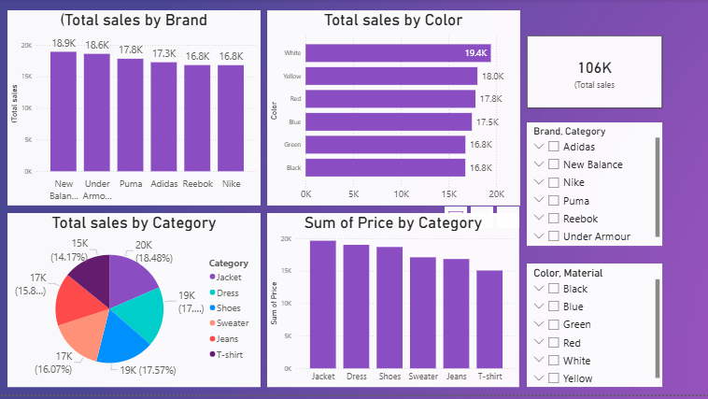

Slide 4
📊 Zara Sales Performance Dashboard (power BI)
Work Done in This Power BI Dashboard
Designed a clean and well-structured Power BI sales dashboard to analyze overall business performance.
Used multiple visualizations including Column Charts, Bar Charts, Pie/Donut Charts, KPI Cards, and Slicers for effective data representation.
Analyzed total sales performance using KPI cards to provide a high-level business overview.
Performed brand-wise sales analysis to identify the top-performing brand.
Conducted category-wise and color-wise sales analysis to understand customer demand and product trends.
Evaluated sales volume based on promotions to measure the impact of promotional activities.
Analyzed sales by product positions (Aisle, End-cap, Front of Store) to support retail merchandising decisions.
Compared seasonal and non-seasonal sales performance to identify seasonality patterns.
Implemented interactive slicers for brand, category, color, material, and product name to enable dynamic and user-driven analysis.
Developed the dashboard with a strong focus on business insights and data-driven decision-making.

Slide 5
